Slide 1
Spock presentation

Slide 2
Spock – but why?
Build in mechanism for mocking and stubing
Leverages groovy syntax
Supports behavioral way of writing tests

Slide 3
Maven dependency (mandatory )
<!-- Mandatory dependencies for using Spock -->
<dependency>
<groupId>org.spockframework</groupId>
<artifactId>spock-core</artifactId>
<version>1.0-groovy-2.0</version>
<scope>test</scope>
</dependency>

Slide 4
Junit vs Spock
Junit | Spock
TestClass | Specification
@Before | setup()
@After | cleanup()
Assertion | Condition is enough (e.g. value == true)
@Test | Method within Specification

Slide 5
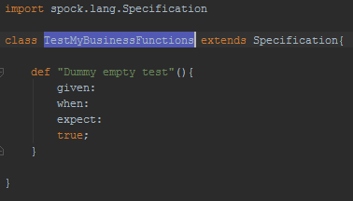
First Test

Slide 6
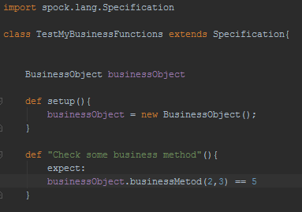
Second Test

Slide 7
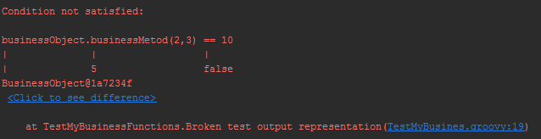
Test failed? See the output

